Slide 1
Introduction to HTML

Slide 2
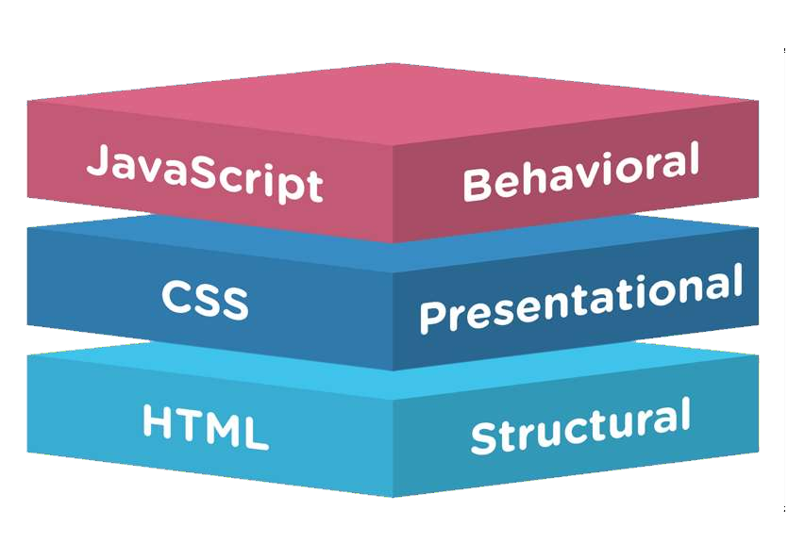
HTML vs CSS vs JAVASCRIPT
Overview

Slide 3
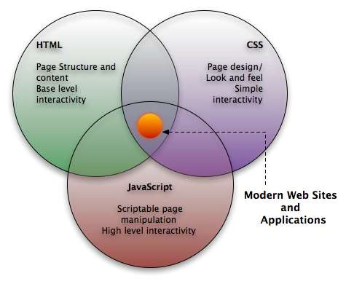
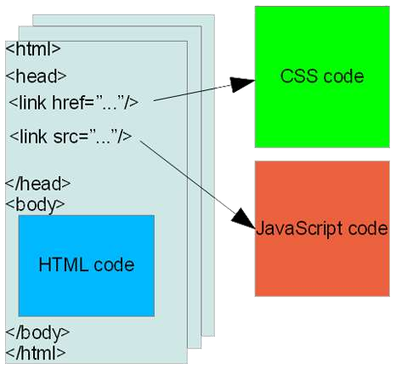
HTML vs CSS vs JAVASCRIPT
Overview

Slide 4
HTML is a markup language describes how your content looks in web browser.
Overview
Tim Berners-Lee was the author of html, with his team at CERN.
The HTML that Tim invented was strongly based on SGML (Standard Generalized Mark-up Language).
Hypertext Markup Language (First Version of HTML) was formally published on June 1993.
Platform independent.
Current version of is HTML5.
Markup languages are designed for the processing, definition and presentation of text by set of
markup tags.
Allow to embed other scripting languages.

Slide 5
History of HTML
1991
HTML first published
1995
HTML 2.0
After HTML 4.01 was released, focus shifted to XHTML and its stricter standards.
1997
HTML 3.2
1999
HTML 4.01
XHTML 2.0 had even stricter standards than 1.0, rejecting web pages that did not comply. It fell out of favor gradually and was abandoned completely in 2009.
2000
XHTML 1.0
2002 -2009
HTML5 is much more tolerant and can handle markup from all the prior versions.
XHTML 2.0
HTML5
Though HTML5 was published officially in 2012, it has been in development since 2004.
2012

Slide 6
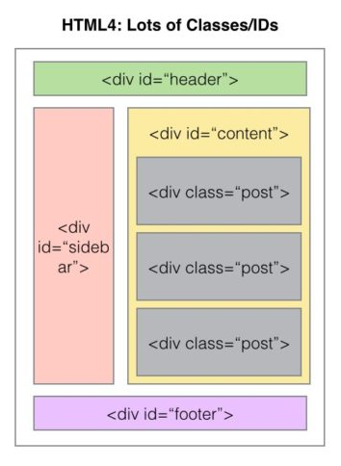
HTML 4 Structure

Slide 7
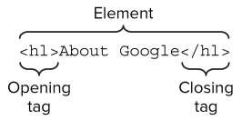
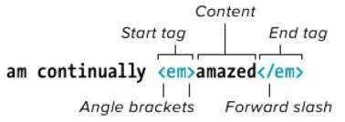
HTML Tags and Elements
Tags are enclosed in angle brackets < >
For Eg.: <html> Opening Tag, </html> Closing Tag.
Element is the combination of (opening & closing Tags and the content between them).
For Eg.:
<p>Part of this text is <b>bold</b>. </p> is a PARAGRAPH element that contains a BOLD element
An HTML document is a collection of elements (text/media with context).

Slide 8
Empty tags vs Container tags
Some elements which does not requires closing tags, are known as Empty Tags or Elements.
For Eg.:
<img src=“peoplestrategists_logo.jpg” alt=“People Strategists Logo” />
<br /> begining of new line. BR stands for BReak.
<hr /> puts a line across the page. HR stands for Horizontal Rule.
The elements which requires opening and closing tags, are known as Container Tags or Elements.
For Eg.:
<h1> This is a heading </h1>
<p> This is a paragraph </p>

Slide 9

HTML Attributes and Values
HTML elements can have attributes which provides additional information about an element.
Always specified in the opening tag and should contained value.
For Eg.:
<!DOCTYPE html>
<html>
<head>
<title>Align Attribute Example</title>
</head>
<body>
<p align="left">This is left aligned</p>
<p align="center">This is center aligned</p>
<p align="right">This is right aligned</p>
</body>
</html>
This is left aligned
This is center aligned
This is right aligned

Slide 10
Some Important Attributes
Attribute | Options | Function
title | User Defined | "Pop-up" title of the elements.
href | User Defined | The link address is specified in the href attribute opens.
class | User Defined | Classifies an element for use with Cascading Style Sheets.
id | User Defined | Names an element for use with Cascading Style Sheets.
bgcolor | numeric, hexidecimal, RGB values | Places a background color behind an element
background | URL | Places a background image behind an element
align | right, left, center | Horizontally aligns tags
valign | top, middle, bottom | Vertically aligns tags within an HTML element.
width | Numeric Value | Specifies the width of tables, images, or table cells.
height | Numeric Value | Specifies the height of tables, images, or table cells.

Slide 11
Structural Elements
A standard HTML document has two main structural elements
head contains setup information for the browser & the Web page
For E.g., the title for the browser window, style definitions, JavaScript code, …
body contains the actual content to be displayed in the Web page
<html lang=“en”>
<head>
<meta charset=“UTF-8” />
<title>My first HTML document</title>
</head>
<body>
<p> Hello world! </p>
</body>
</html>

Slide 12
Comments and doctype
HTML has a mechanism for embedding comments that are not displayed when the page is rendered in a browser.
Eg.: <!-- This is comment text -->
Besides tags, text content, and entities, an HTML document must contain a doctype declaration as the first line. For
Eg.:
Current version of HTML is 5 and it makes use
of the following declaration: <!DOCTYPE html>
<!DOCTYPE html>
<html lang=“en”>
<head>
<meta charset=“UTF-8” />
<title>My first HTML document</title>
</head>
<body>
<p> Hello world! </p>
</body>
</html>

Slide 13
<head> and <body> Elements
The <head> element is where you include a <title> element (that appears in the title bar of the browser).
You can also include lots of other type of information in the <head> element.
Cascading Style sheet information, or a link to an external style sheet (or several).
“Meta” data, such as who authored the page, the type of content, and clues that search engines may (or may not) use to help categorize your page.
JavaScript code.
The <body> element contains the main bulk of the material to be displayed on the webpage.
Paragraphs.
Tables and lists.
Images.
JavaScript code.
PHP code can be included here too (if passed through a PHP parser before being served to the client’s browser).
Other embedded objects (videos, etc).

Slide 14
<head> Elements
Meta tags
The <meta> tag provides metadata about the HTML document.
Meta elements are typically used to specify page description, keywords, author of the document, last modified, and other metadata.
Some examples –
Example 1 - Define keywords for search engines:
<meta name="keywords, description " content="HTML, CSS, XML, XHTML, JavaScript">
Example 3 - Define the author of a page:
<meta name="author" content="Hege Refsnes">
Example 4 - Refresh document every 30 seconds:
<meta http-equiv="refresh" content="30">

Slide 15
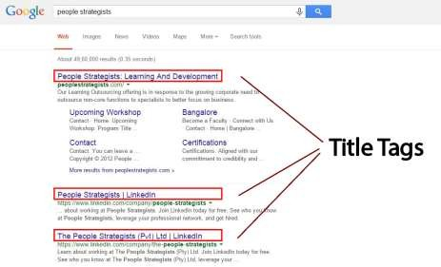

<head> Elements (Cont.)
Title Tag
The <title> tag is required in all HTML documents and it defines the title of the document.
The <title> element: Defines a title in the browser toolbar.
Provides a title for the page when it is added to favorites. Displays a title for the page in search-engine results.
Eg.:

Slide 16
<head> Elements (Cont.)
Link Tag
The <link> tag defines a link between a document and an external resource.
In HTML the <link> tag has no end tag.
Some Imp. Attributes – charset, - To know browser, which character encoding is used.
href, - hyperlink.
rel, - Relation between linked document.
target. – It specifies where to open the linked document.
Example –
<head>
<link rel="stylesheet" type="text/css" href="theme.css">
</head>

Slide 17
<head> Elements (Cont.)
Script Tags
The <script> tag is used to define a client-side script, such as a JavaScript.
The <script> element either contains scripting statements, or it points to an external script file through the src attribute.
Example -
<html>
<head>
<title>Align Attribute Example</title>
</head>
<body>
<p id="demo"></p>
<script>document.getElementById("demo").innerHTML
= "Hello JavaScript!"; </script>
</body>
</html>
Hello JavaScript!

Slide 18
<head> Elements (Cont.)
Style Tag
The <style> tag is used to define style information for an HTML document.
Inside the <style> element you specify how HTML elements should render in a browser.
Example-
<html>
<head>
h1 {color:red;}
p {color:blue;}
</head>
<body>
<h1>A heading</h1>
<p>A paragraph.</p>
</body>
</html>
This is a heading
This is a paragraph.

Slide 19
Elements for the BODY section
Block-level elements
The BODY of a document consists of multiple block elements. If plain text is found inside the body, it is
assumed to be inside a paragraph P. See the syntax rules for an explanation of the syntax used in the overview.
Headings
H1 - Level 1 header H2 - Level 2 header H3 - Level 3 header H4 - Level 4 header H5 - Level 5 header H6 - Level 6 header
Text containers
P - Paragraph
PRE - Preformatted text BLOCKQUOTE - Large quotation ADDRESS - Address information
Text Level Elements Logical Markups Physical Markups Special Markups
Lists
UL - Unordered list OL - Ordered list DIR - Directory list
MENU - Menu item list LI - List item
DL - Definition list
DT - Definition term
DD- Definition
Others
DIV - Logical division CENTER - Centered division FORM - Input form
HR - Horizontal rule TABLE - Tables

Slide 20
Elements for the BODY section
Headings
There are 6 types of heading tags.
Eg.: –
<html>
<body>
<h1>This is heading 1</h1>
<h2>This is heading 2</h2>
<h3>This is heading 3</h3>
<h4>This is heading 4</h4>
<h5>This is heading 5</h5>
<h6>This is heading 6</h6>
<p><b>Tip:</b> Use h1 to h6 elements only for headings. Do not use them just to make text bold or big. Use other tags for that.</p>
</body>
</html>
This is heading 1
This is heading 2
This is heading 3
This is heading 4
This is heading 5
This is heading 6
Tip: Use h1 to h6 elements only for headings. Do not use them just to make text bold or big. Use other tags for that.

Slide 21
Elements for the BODY section (Cont.)
<p> - Paragraph Tag and <pre> - Preformatted Tag
<p> Tag - Another way to structure your text in paragraph forms.
<Pre> Tag - is used to apply structural exactness.
Eg.:
<html>
<body>
<p>This is a paragraph of text.</p>
<p>This is a second paragraph of text.</p>
<pre>This is preformatted text with exact space, line and breaks.</pre>
</body>
</html>
This is a paragraph of text.
This is a second paragraph of text.
This is preformatted text with
line and breaks.
exact space,

Slide 22
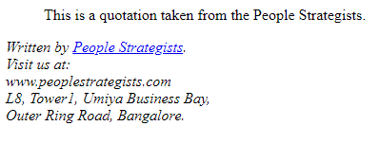
Elements for the BODY section (Cont.)
<blockquote> Tag and <address> Tag Blockquote Tag - Indicates that the enclosed text is an extended quotation. Address Tag - Address Information of the Author/Owner.
Eg.:
<html> <body> <blockquote cite="http://http://peoplestrategists.com/"> <p>This is a quotation taken from the People Strategists.</p> </blockquote> <address> Written by <a href="mailto:info@peoplestrategists.com">People Strategists</a>.<br> Visit us at:<br> www.peoplestrategists.com<br> L8, Tower1, Umiya Business Bay,<br> Outer Ring Road, Bangalore. </address> </body> </html>

Slide 23
Elements for the BODY section (Cont.)
Text Formatting Elements
Physical markup
TT - Teletype I - Italics
B - Bold
U - Underline STRIKE - Strikeout BIG - Larger text SMALL - Smaller text SUB - Subscript
SUP - Superscript
Logical markup
EM - Emphasized text STRONG - Strongly emphasized DFN - Definition of a term CODE - Code fragment
SAMP - Sample text KBD - Keyboard input VAR - Variable
CITE - Short citation
Special markup A - Anchor IMG - Image
BASEFONT - Default font size APPLET - Java applet
PARAM - Parameters for Java applet
FONT - Font modification
BR - Line break
MAP - Client-side imagemap AREA - Hotzone in imagemap

Slide 24
Elements for the BODY section (Cont.)
Text Formatting Elements (Physical Markup)
Tag Description
<b>….</b>
<i>……</i>
<u>….</u>
<strike>…</strike>
<sub>….</sub>
<sup>….</sup>
<big>….</big>
<small>….</small>
<tt>….</tt>
bold.
italic.
underline.
strikethrough.
subscript.
superscript.
bigger font (one font size bigger).
small font (one font size smaller).
typewriter (monospaced).

Slide 25
Elements for the BODY section (Cont.)
Text Formatting Elements (Physical Markup)
<html> <body> | Snapdeal Academy. Java Training.
<b> Snapdeal Academy. </b> <br> <i> Java Training. </i> <br> | Powered by - PeopleStrategists. Text. Copyright © Jasper Infotech Pvt.Ltd. _{Subscipt.} ^{Superscript.}
<u> Powered by - PeopleStrategists. </u> <br>
<strike> Text. </strike> <br>
<small> Copyright &copy Jasper Infotech Pvt.Ltd. </small>
<sub> Subscipt. </sub>
<sup> Superscript. </sup>
</body> </html>

Slide 26
Elements for the BODY section (Cont.)
Text Formatting Elements (Logical Markup)
Tag
<em>
<strong>
<dfn>
<code>
<kbd>
<var>
<cite>
Description
Emphasized
Strongly emphasized
A definition
Represents computer code
keyboard characters
Program variable
A citation

Slide 27
Elements for the BODY section (Cont.)
Text Formatting Elements (Logical Markup)
<html> <body> | Snapdeal Academy. Java Training.
<em> Snapdeal Academy. </em> <br> <strong> Java Training. </strong > <br> <dfn> Powered by - PeopleStrategists. </dfn > <br> | Powered by - PeopleStrategists. Text. Subscipt. Superscript. Superscript.
<code> Text. </code> <br>
<kbd> Subscipt. </kbd>
<var> Superscript. </var>
<cite> Superscript. </cite>
</body> </html>

Slide 28
Elements for the BODY section (Cont.)
Text Formatting Elements (Special markup)
Links and Navigation
Anchor Element-
An anchor can be used to create a link to another document (with the href attribute).
Types –
External : <a href=“https://www.peoplestrategists.com”>Welcome to PeopleStrategists</a>
Internal : <a href=“\contact.htm”>contact</a>
Image Tag-
The syntax for the tag to insert image into the webpage is-
<img src=“url” alt=“alternate text”>
Eg.: <img src=“\images\snapdealacademy.jpg” alt=“Snapdeal Academy”>

Slide 29
Elements for the BODY section (Cont.)
Unordered List and Odered Lists
Unordered Lists - <ul> tag. Item lists in <li> tag. The list items will be marked with bullets.
Ordered Lists - <ol> tag. Item lists in <li> tag. . The list items will be marked with numbers.
Eg.:
<html>
<body>
<h2>Unordered List </h2>
<ul>
<li>Java</li>
<li>Python</li>
<li>Ruby</li>
</ul>
<h2>Ordered List </h2>
<ol>
<li>Java</li>
<li>Python</li>
<li>Ruby</li>
</ol>
</body>
</html>
Unordered List
Java
Python
Ruby
Ordered List
Java
Python
Ruby

Slide 30
Elements for the BODY section (Cont.)
Div Tag
<div> tag – Used to defines a division or a section in an HTML document. And to group block-
elements to format them with CSS.
Eg.:
<html>
<body>
<div style="color:#00FF00">
<h2>Snapdeal Academy</h2>
<p>Welcome to Java Training</p>
</div>
</body>
</html>
Snapdeal Academy
Welcome to Java Training.

Slide 31
Elements for the BODY section (Cont.)
Table Element
<table> Tag : <tr> | Table Row - | Defines a new row,
<td> | Table Data - | Defines a single cell,
<th> | Table Headings - | Defines header cell.
<html>
<body>
<style> table, th, td { border: 1px solid black; }
</style>
<table>
<tr>
<th>Day</th> <th>Session</th>
</tr>
<tr>
<td>Thursday</td> <td>HTML</td>
</tr>
<tr>
<td>Friday</td> <td>CSS</td>
</tr>
</table>
</body>
</html>
Day | Session
Thursday | HTML
Friday | CSS

Slide 32
Elements for the BODY section (Cont.)
Form Elements
<form> - It is a method of accepting inputs from user. A form is an area that can contain form
elements.
Eg.:
<form name=“form1” action="abc.asp" method=get>
<!- form elements -->
</forms>
Name- is used for future manipulation of data by scripting language.
Action- indicates a program on the server that will be executed when this form is submitted. Mostly it will be an
ASP or a CGI script.
Method- indicates the way the form is submitted to the server - popular options are GET/POST.

Slide 33
Elements for the BODY section (Cont.)
Form Elements
Form Elements | Description
Text Field | Can create a Text Field by using Input Element with Type Attribute.
Pass Word Field | When text is entered in Pass Word Field it shows **** Symbol
Combo Box | It can have multiple values and it allows user to select one value at a time
List Box | It can have multiple values and allows user to select more than one value at a time
Radio Button | Can create a Radio Button by using Input Element with Value and Name Attribute
Check Box | Can create Check box by Using Input Element
Command Button | This is useful for submitting any data that is helpful in transferring data across different interfaces

Slide 34
Elements for the BODY section (Cont.)
Form Elements
See example

Slide 35
Elements for the BODY section (Cont.)
Character Entities
Some characters like the < character, have a special meaning in HTML, and therefore cannot be used in
the text. The most common character entities:
Result | Description | Entity Name
< > & “ ‘ | non-breaking space less than greater than ampersand quotation mark apostrophe | &nbsp; &lt; &gt; &amp; &quot;&aps;
Some Other Commonly Used Character Entities
© | copyright | ;&copy;
® | registered trademark | &reg;
£ | pound | &pound;
¥ | yen | &yen;

Slide 36



Slide 37
Overview
Advance version of HTML.
In 2008, the first HTML5 public draft was released
HTML5 W3C Final Recommendation was released 28. October 2014.
New elements, attributes, and behaviors were introduced.
It helps to create more powerful website and interactive web applications.
HTML5 comes with XML syntax.
HTML5 is to compete with Flash and Silverlight.
Empowering Mobile devices.

Slide 38
Technical Advantages Over Previous Version.
Audio and Videos are integral part of HTML5 specifications e.g. <audio> and<video> tags.
Vector graphics is integral part of HTML5 e.g. SVG and canvas.
JS GeoLocation API in HTML5 helps identify location of user browsing any website
(provided user allows it).
Full duplex communication channels can be established with Server using Web Sockets.
Allows JavaScript to run in background. This is possible due to JS Web worker API in HTML5.
Application Cache, Web SQL database and Web storage is available as client side storage.
Retain Backward Compatibility with previous versions of HTML5.

Slide 39
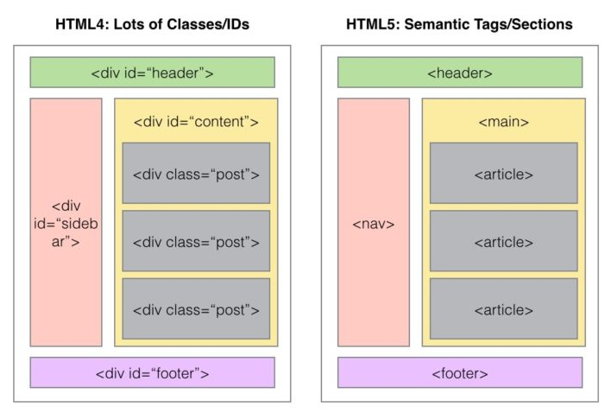
HTML4 vs HTML5 Page Structure

Slide 40
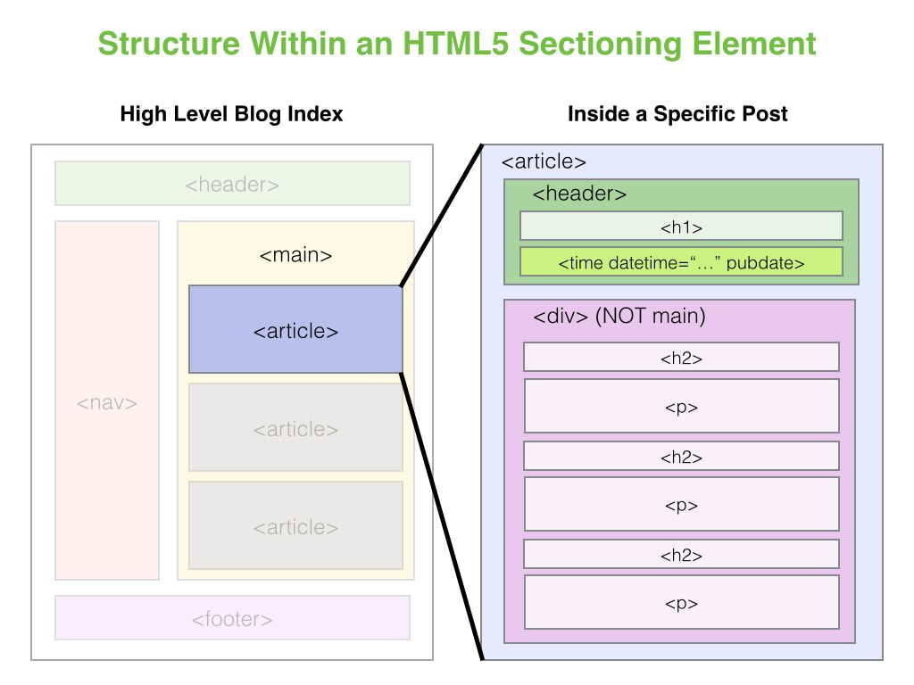
HTML4 vs HTML5 Page Structure

Slide 41
HTML5 Technology Functions
Semantics: allowing you to describe more precisely what your content is.
Connectivity: allowing you to communicate with the server in new and innovative ways.
Offline & Storage: allowing webpages to store data on the client-side locally and operate offline more efficiently.
Multimedia: making video and audio first-class citizens in the Open Web.
2D/3D Graphics & Effects: allowing a much more diverse range of presentation options.
Performance & Integration: providing greater speed optimization and better usage of computer hardware.
Device Access: allowing for the usage of various input and output devices.
Styling: letting authors write more sophisticated themes.

Slide 42
HTML5 New Tags and Elements
HTML5 Indroduces 28 New Elements, Some of them are mentioned here.
Navigation:
<article>
<aside>
<header>
<hgroup>
<footer>
<figure>
<figcaption>
<nav>
<section>
Multimedia/Interactivity:
<audio>
<canvas>
<embed>
<source>
<track>
<video>
New <input> types:
color date datetime
datetime-local email
month number range search tel
time url week
Miscellaneous:
<bdi>
<command>
<datalist>
<details>
<keygen>
<mark>
<meter>
<output>
<progress>
<summary>
<rp>
<rt>
<ruby>
<time>
<wbr>

Slide 43
Elements removed in HTML5
Element | Use instead
<acronym> | <abbr>
<applet> | <object>
<basefont> | CSS
<big> | CSS
<center> | CSS
<dir> | <ul>
<font> | CSS
<frame>
<frameset>
<noframes>
<strike> | CSS
<tt> | CSS

Slide 44
Migration from HTML4 to HTML5
HTML4 | HTML5
<div id="header"> | <header>
<div id="menu"> | <nav>
<div id="content"> | <section>
<div id="post"> | <article>
<div id="footer"> | <footer>

Slide 45
Defining HTML5 Documents
Remember the DOCTYPE declaration-
<!DOCTYPE html>
Again, HTML5 simplifies this line:
<html lang="en">
The default character encoding (charset) declaration
<meta charset="UTF-8">

Slide 46
Semantic Elements
A semantic element clearly describes its meaning to both the browser and the developer.
Eg. of non-semantic elements: <div> and <span> - Tells nothing about its content. Eg. of semantic elements: <form>, <table>, and <img> - Clearly defines its content.
Many web sites contain HTML code like: <div id="nav"> <div class="header"> <div id="footer">
to indicate navigation, header, and footer.
HTML5 offers new semantic elements to define different parts of a web page:
<article>
<aside>
<details>
<figcaption>
<figure>
<footer>
<header>
<main>
<mark>
<nav>
<section>
<summary>
<time>

Slide 47
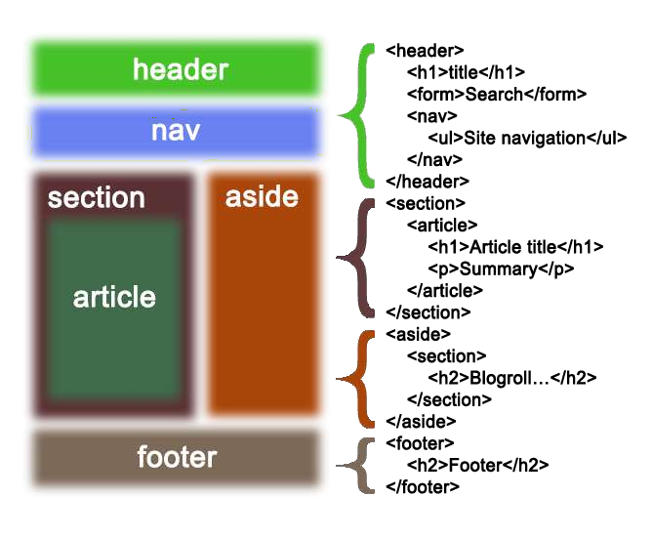
Semantic Elements

Slide 48
Graphics API
(Canvas and SVG)
Previously possible with Flash, VML, Silverlight.
Very complex to do in JavaScript without plugins (for example, rounded corners or diagonal lines).
Provide native drawing functionality on the Web.
Completely integrated into HTML5 documents (Part of DOM). Can be styled with CSS.
Can be controlled with JavaScript.

Slide 49
(Canvas and SVG)
Both have their own unique features and can be used combined.
Canvas | SVG
Low level | High Level
Immediate mode | Retained mode
Fixed size | Scalable
Best for keyboard-based apps | Best for mouse-based apps
Animation (no object storage) | Medium animation
Pixels | XML object model
No interaction | User interaction (hit detection, events on the tree)

Slide 50
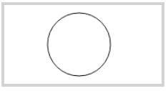
Canvas
<canvas> element as “a resolution-dependent bitmap canvas which can be used for rendering graphs, game graphics, or other visual images on the fly.” A canvas is a rectangle in your page where you can use JavaScript to draw anything you want and CSS for styling. In 2D context and 3D context (Web GL).
Eg.:
<canvas id="myCanvas" width="200" height="100" style="border:4px solid #d3d3d3;">
Your browser does not support the HTML5 canvas
tag.</canvas>
<script>
var c = document.getElementById("myCanvas"); var ctx = c.getContext("2d");
ctx.beginPath(); ctx.arc(95,50,40,0,2*Math.PI); ctx.stroke();
</script>

Slide 51


SVG – Scalable Vector Graphics
<svg> element Modularized, XML-based language for describing 2D vector and mixed vector/raster
graphics. You can zoom SVG graphics to any level.
Eg.:
<svg width="100" height="100">
<circle cx="50" cy="50" r="40"
stroke="blue" stroke-width="4" fill="orange" />
Sorry, your browser does not support inline SVG.
</svg> <br>
<svg width="300" height="200">
<polygon points="100,10 40,198 190,78 10,78
160,198"
style="fill:red;stroke:black;stroke-width:5;fill- rule:evenodd;" />
Sorry, your browser does not support inline SVG.
</svg>

Slide 52
HTML5 Media Elements - Audio and Video
<audio> and <video>- are two new HTML5 media elements can be controlled using Audio/Video API, have native support in the browser (Embedded Codecs).
AV Containers and Codecs
Audio and Video containers H264 and Ogg.
Audio and Video codecs (algorithm used to encode and decode an audio or video stream)
Audio – AAC, MP3, Vorbis. Video – H264, MP4, Theora.
You can add multiple formats per (Audio/Video).

Slide 53
HTML5 Local Storage
With local storage, web applications can store data locally within the user's browser. Local storage don’t use cookies unlike previous versions, it is more secure and can store large amounts of data locally, without any performance issue.
It provides two objects for storing data on the client: window.localStorage - stores data with no expiration date.
window.sessionStorage - stores data for one session (data is lost when the tab is closed).

Slide 54
HTML5 Offline Web Application a.k.a - Application Cache
Offline Web Applications
HTML5 allows detection of online/offline mode.
Users can continue to interact with web applications and documents when their network connection is unavailable.
Cached resources load faster.
It reduces server load – only updated/changed resources from the server.
Eg.: Gmail.
Use of cache manifest file with details about files to be cached. Browsers cache data is in the application cache.

